Slide 1
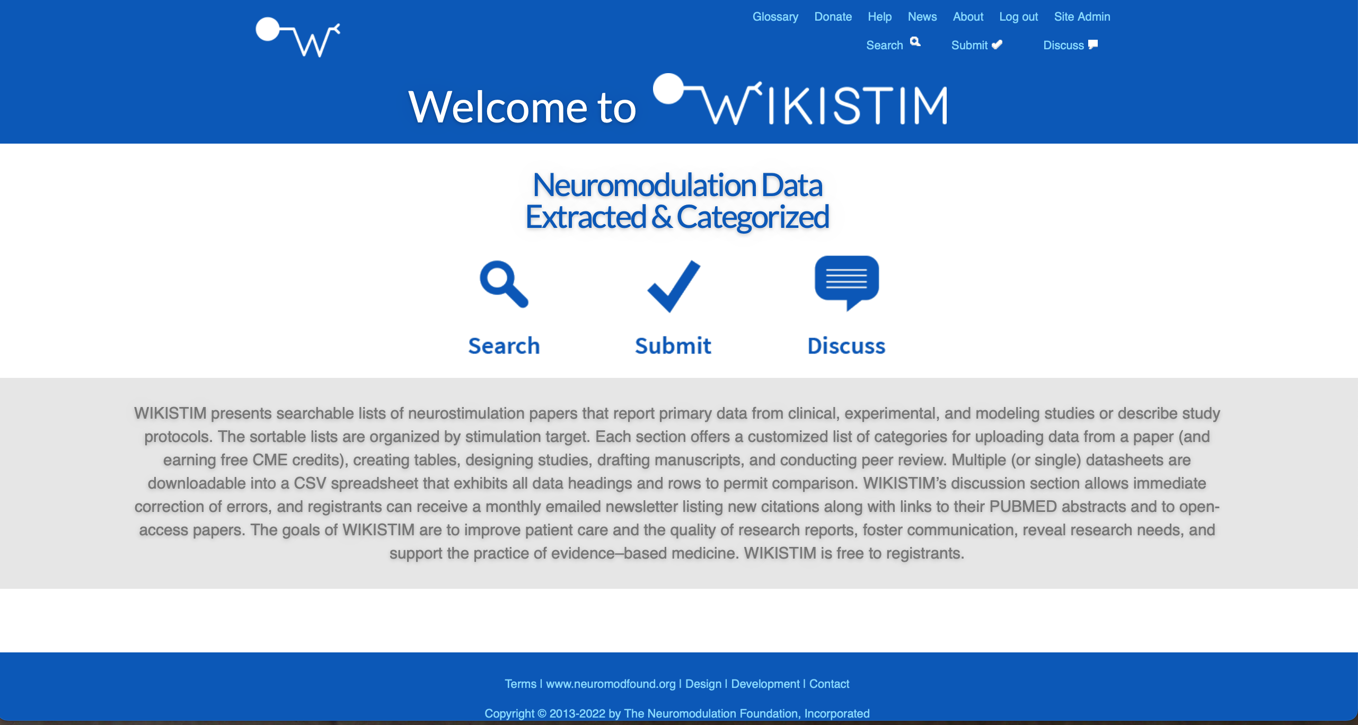
www.wikistim.org

Slide 2
Why WIKISTIM?
We rely on neurostimulation data to improve patient care by informing regulatory submissions, study design, practice decisions, reimbursement, etc.
www.wikistim.org

Slide 3
Challenges to accessing neurostimulation data:
www.wikistim.org
The repositories of abstracts (e.g., PubMed) respond best to expert search techniques that yield sufficiently specific and sensitive results. Even then, time-consuming curation is required to remove “noise” from search results.
Abstracts routinely omit important data.
Literature on the same topic is published in a host of journals,
Access to this literature is expensive.

Slide 4
www.wikistim.org
How does WIKISTIM help us access neurostimulation data?
WIKISTIM provides human-curated, searchable citation lists of reports that provide primary data or study protocols. These lists are organized by stimulation target (currently SCS, DRG, DBS, PNS, SNS, and GES, with NBS under development). Monthly updates and links are listed in WIKISTIM newsletters emailed to registrants.
Citations listed in WIKISTIM are linked to available PUBMED entries and to free full-text articles.

Slide 5
Challenges to generating neurostimulation data:
www.wikistim.org
Study results can be flawed when biases and mistakes lead to inappropriate research techniques (e.g., study design, patient selection, outcome measures, data analysis, etc.) for a given study question.

Slide 6
www.wikistim.org
How does WIKISTIM help us generate neurostimulation data?
WIKISTIM provides data sheets comprising ~ 200 fields for each stimulation target to support data abstraction using narrative or numeric entries
Uncompleted data sheets provide templates that support the development of research protocols and preparation of manuscripts by encouraging the inclusion of important data. They also facilitate peer review.

Slide 7
Challenges to analyzing neurostimulation data:
www.wikistim.org
Meta-analyses, HTAs, “guidelines,” literature reviews:
Can (and do) incorporate mistakes
Are fixed in time and, thus, are immediately out-of-date
Are constrained by the subjective interests and inherent biases of the authors
Are static rather than searchable/updatable
Provide limited data visualization

Slide 8
www.wikistim.org
How does WIKISTIM help us analyze neurostimulation data?
Raw data sheets can be downloaded, completed, uploaded, and then downloaded again from search results or a citation list into a table to support rapid, up-to-date analysis and comparison of data.
When downloaded as a PDF, a data sheet presents each group heading and the fields with values added. When downloaded as a CSV file, every field appears to support comparison (downloaded table is too large to illustrate here).

Slide 9
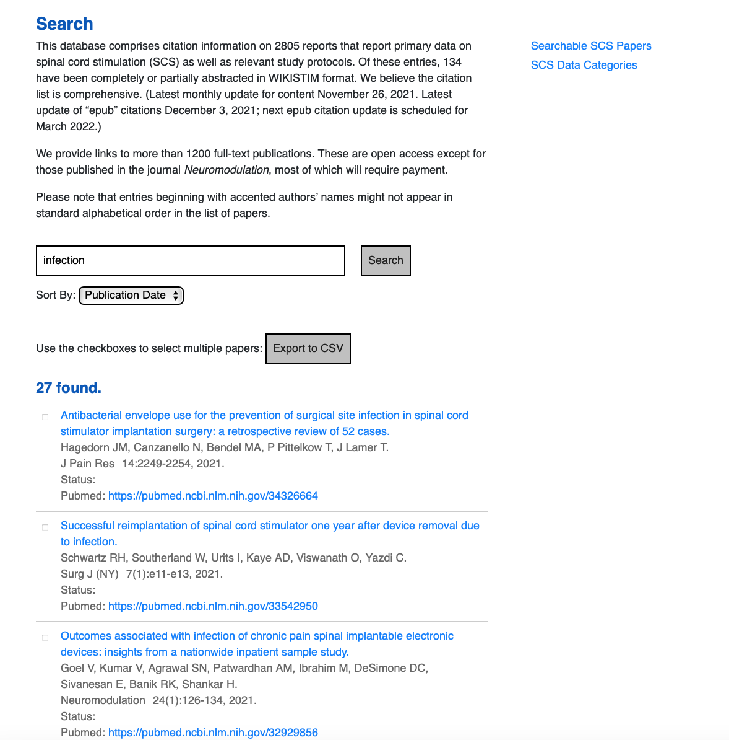
A sample screen in the Search SCS section. Citations can be downloaded into letter-oriented PDF format (see Slide 10).

Slide 10
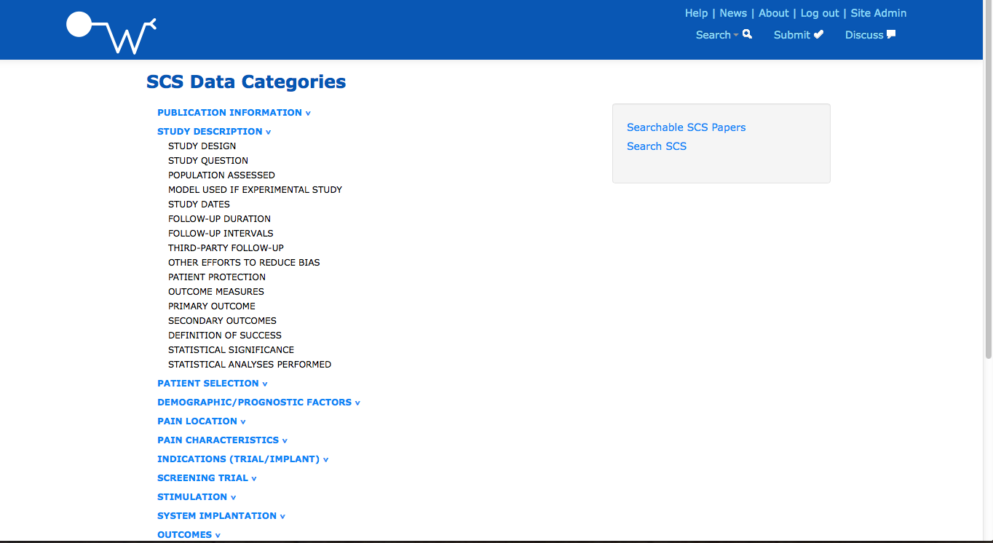
A sample screen in the list of SCS data categories that comprise the SCS data sheet. Each heading drops down as indicated.

Slide 11
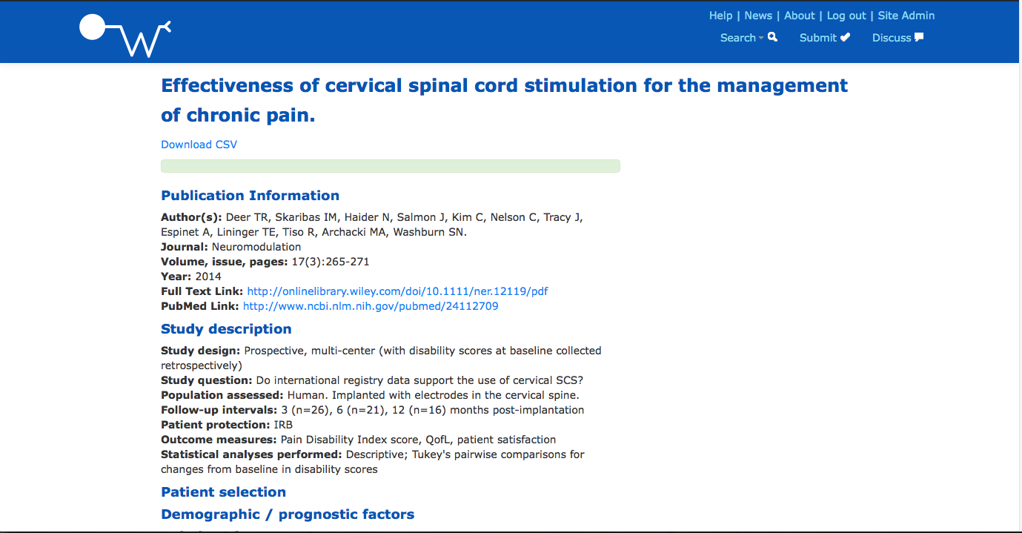
The beginning of a completed data sheet viewed online.

Slide 12
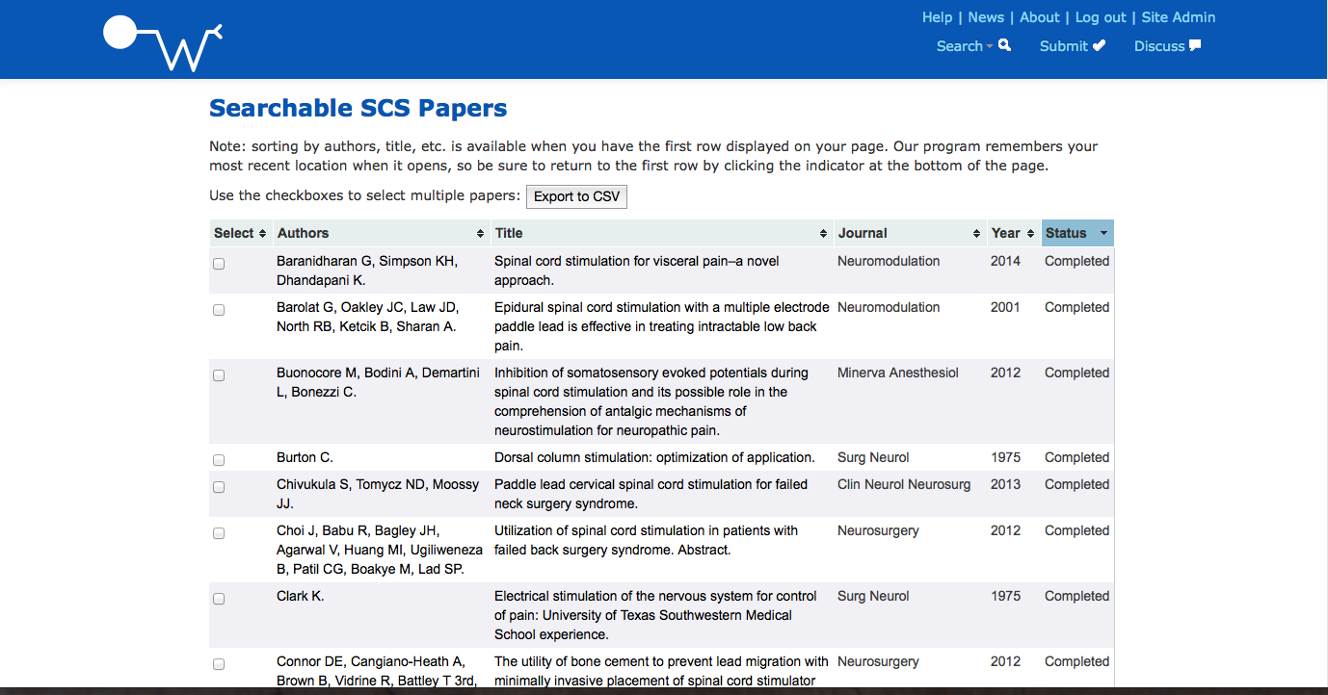
Completed data sheets can be identified by sorting the list of citations by “status” or by searching “completed” in a section.

Slide 13
www.wikistim.org
WIKISTIM and Collaboration
The WIKISTIM discussion section offers an excellent means for members of the neurostimulation community to discuss current topics and controversies.
The discussion section can be used to submit corrections and citations, suggest data fields and citations, and offer advice.

Slide 14
www.wikistim.org
Citation status as of February 15, 2025
 | Aug 2021 | Aug 2022 | Aug 2023 | Aug 2024 | Feb 2025
Deep brain stimulation | 6,364 | 7,061 | 7,747 | 8,466 | 8,815
Dorsal root ganglion stimulation | 200 | 229 | 254 | 280 | 297
Gastric electrical stimulation | 510 | 518 | 522 | 528 | 530
Meta-analyses |  |  |  |  | 51
Peripheral nerve stimulation | 564 | 635 | 714 | 816 | 867
Spinal cord stimulation | 2,745 | 2,938 | 3,172 | 3,350 | 3,488
Sacral nerve stimulation | 1,090 | 1,139 | 1,186 | 1,242 | 1,277
Total | 11,473 | 12,520 | 13,595 | 14,682 | 15,325
In the pipeline:
Non-invasive brain stimulation section
Vagus nerve stimulation awaiting funding

Slide 15
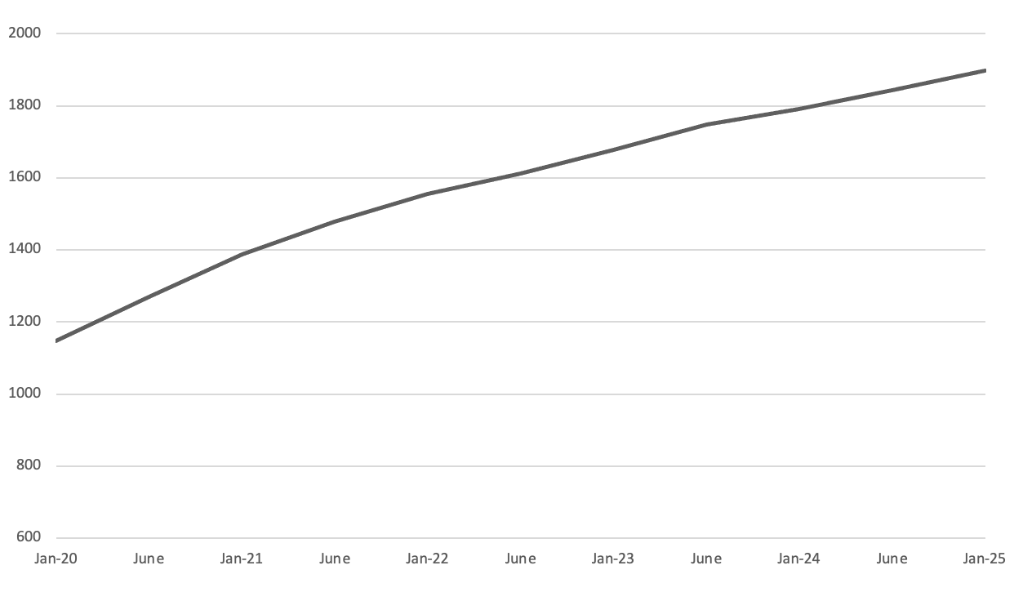
www.wikistim.org
1898 subscribers ~ 34 countries as of Feb 2025

Slide 16
www.wikistim.org
The goals of WIKISTIM are to improve patient access and care by:
Facilitating study design and reporting through use of WIKISTIM’s data sheets, which provide templates for research protocols and manuscripts, encourage inclusion of important data, and facilitate peer review
Fostering communication and collaboration
Extending the useful life of publications
Eliminating the need for researchers conducting meta-analyses to recreate the wheel

Slide 17
www.wikistim.org
Newsletter
Each month, we email a newsletter listing the citations added in each stimulation section along with links to their PubMed abstracts and Free Full Text (when available).
We add commentary when a pertinent subject calls for it.
These newsletters are archived without a password barrier under NEWS on the WIKISTIM home page.
The newsletters perform above expectation for our sector (see next slide).

Slide 18
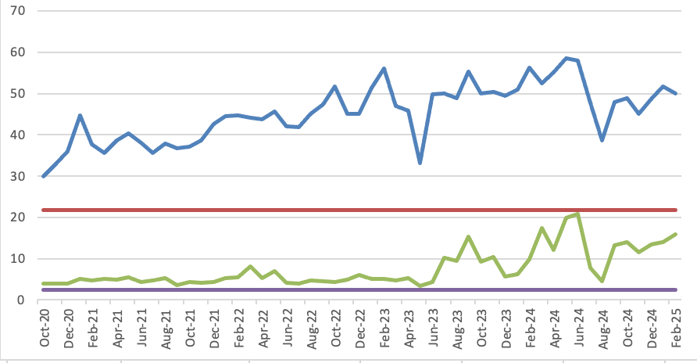
www.wikistim.org
Newsletter performance as of February 2025; these data are from emailed newsletters not those accessed from our homepage.
Percent opened (blue) versus industry standard* (red) and percent clicks (green) versus industry standard (purple).
*Medical, dental, and healthcare sector mailchimp.com

Slide 19
www.wikistim.org
WIKISTIM What Will the Future Bring?
Forms that facilitate online data submission (incorporating reward elements of gaming)
Additional sections, such as VNS, and ONS
The use of AI to fill in data sheets is undergoing investigation by an academic team
Links from data fields to additional information
A dynamic user experience (saved search results, customized site behavior, automatic updates of searches) with data presented graphically using cutting-edge data visualization techniques

Slide 20
www.wikistim.org
We urge you to join in this effort by:
Registering for WIKISTIM (the process is free and easy)
Spreading the word about WIKISTIM
Making a donation and/or encouraging companies that make educational grants to support WIKISTIM
Submitting completed datasheets
Helping us to create new sections

Slide 21
www.wikistim.org
Financial support from inception to date:
BIOTRONIK NRO (matching), Boston Scientific, Enterra Medical, Greatbatch, Medtronic, Nevro, St Jude, Stimwave
The International Neuromodulation Society
The NANS Foundation
The Neuromodulation Foundation, Inc. (WIKISTIM’s parent organization)
The North American Neuromodulation Society
Thomas Abell, MD; Allen Burton, MD; James Brennan, MD; David Cedeno, PhD and Pilar Mejia, PhD; Kenneth Chapman, MD; Terry Daglow; Hemant Kalia, MD, MPH, FIPP; The Donlin & Harriett Long Family Charitable Gift Fund; Mohammad Omar; SuEarl McReynolds; Richard B. North, MD; Louis Raso, MD, PA; B. Todd Sitzman, MD, MPH; Konstantin Slavin, MD, PhD; Sean Slee, PhD

Slide 22
www.wikistim.org
Editor-in-chief, Richard B. North, MD
Section editors
Thomas Abell, MD, Gastric Electrical Stimulation
Tracy Cameron, PhD, Peripheral Nerve Stimulation
Roger Dmochowski, MD, Sacral Nerve Stimulation
Robert Foreman, MD, PhD, Experimental Studies
Elliot Krames, MD, Dorsal Root Ganglion Stimulation
Bengt Linderoth, MD, PhD, Experimental Studies
Richard B. North, MD, Spinal Cord Stimulation
B. Todd Sitzman, MD, MPH, At Large
Konstantin Slavin, MD, PhD, Deep Brain Stimulation
Kristl Vonck, MD, PhD, Section on DBS for Epilepsy
Richard Weiner, MD, Peripheral Nerve Stimulation
Jonathan Young, MD, Noninvasive Brain Stimulation
Managing editor, Jane Shipley
Notes:
Doe Kumsa is a Post-doctoral fellow through the Medical Device Innovation Consortium. She is based at the FDA, where her research is focused on the safety of electrical stimulation. She will present her results gained from analyzing regulatory databases.

